Slide 1
Predicting the health status of cows using machine learning
Name: Sadia Jahan Shanta, Anik Aich, Foyez Ullah Kabir, and Dr. Sifat Momen
Department of Electrical and Computer Engineering,
North South University

Slide 2
OUTLINE
Introduction
Literature Review
Problem Statement
Methodology
Work Flow Diagram
Feature Selection & Machine Learning Model Implementation
Result
Conclusion

Slide 3
INTRODUCTION
Bangladesh's population is predicted to expand by more than 300 million between 2000 and 2030.
Cattles are the primary source of milk and meat in Bangladesh, however it also bring problems such as zoonotic disease transmission.
The health of the cattle has a direct impact on the production and profitability of dairy farms.
Cattle health is important to the socioeconomic development of countries like as Bangladesh.
In this study, machine learning methods are used to determine whether a cow has a health concern.

Slide 4
LITERATURE REVIEW
Chaudhury and colleagues used machine learning and the Internet of Things (IOT) to monitor animal health.
Wagner et al. investigated the use of Machine Learning (ML) in the context of detecting abnormal animal behavior. They looked into several Machine Learning classification techniques where KNNR fared the best, detecting 83% of true positive instances.

Slide 5
PROBLEM STATEMENT
Most of the farmers in Bangladesh are illiterate, so even if their cows are sick, they often don't understand the symptoms and they don't even see a doctor. Due to this, many cows die of various diseases. Again, many diseases spread from cows to humans, thus humans also get sick.
In big farms, many cows have to be taken care of together, which takes a lot of labor. A full-time doctor is needed to check whether so many cows are healthy, which is not possible in a developed country like Bangladesh.
Many times the cow's disease is caught late and many antibiotics and medicines are needed to cure the cow, so the farmers struggle to collect that money.

Slide 6
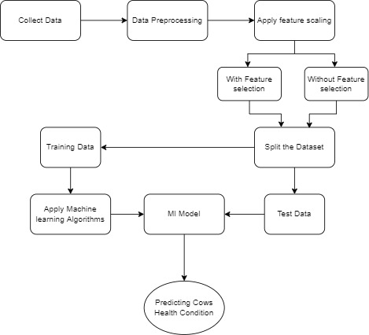
METHODOLOGY (Work Flow)

Slide 7
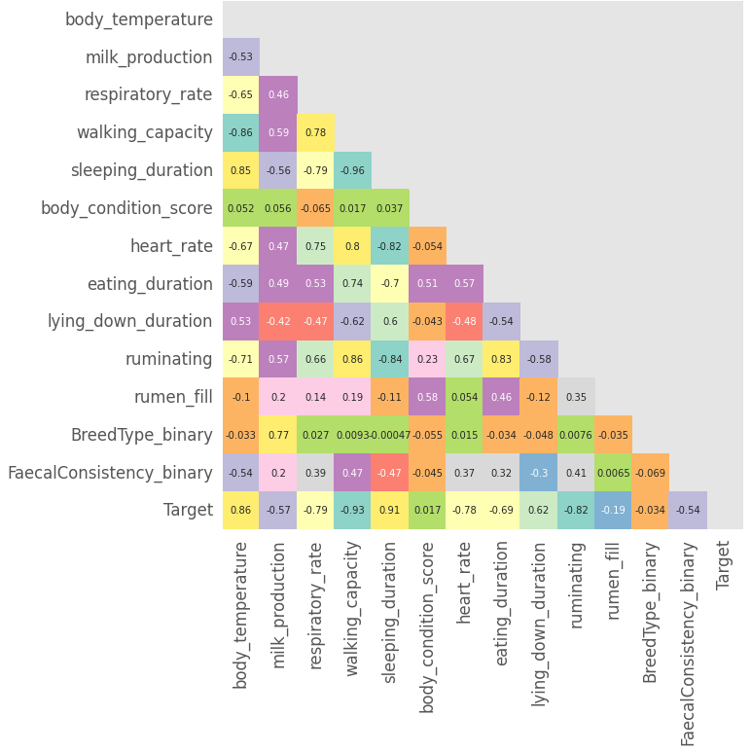
FEATURE SELECTION & MACHINE LEARNING MODEL IMPLEMENTATION
We set the threshold for
this study to 0.85. Because
the correlation between
rumination and walking capacity was determined
to be greater than the threshold value, we decided
to delete walking capacity.
Correlation Matrix of Cattle Dataset
We applied four different classification algorithms: Decision Tree (DT), Random Forest (RF), K Nearest Neighbor (KNN), and Logistic Regression (LR), to learn from the train data.

Slide 8
RESULT (Comparison of classification reports evaluated by Cattle dataset Without Feature Selection)
Classifier Name | Train Accuracy | Test Accuracy | Precision | Recall | F1-score | AUC
Logistic Regression | 100 | 87.88 | 1 | 0.81 | 0.89 | 0.90
Decision Tree | 100 | 93.94 | 1 | 0.90 | 0.90 | 0.95
KNN classifier | 98.47 | 87.88 | 1 | 0.81 | 0.81 | 0.90
Random Forest | 100 | 87.88 | 1 | 0.81 | 0.81 | 0,90
Decision Tree perform the best when the feature selection not applied.

Slide 9
Comparison of classification reports evaluated by Cattle dataset With Feature Selection
Classifier Name | Train Accuracy | Test Accuracy | Precision | Recall | F1-score
Logistic Regression | 98.47 | 100 | 1 | 1 | 1
Decision Tree | 100 | 100 | 1 | 1 | 1
KNN classifier | 95.42 | 100 | 1 | 1 | 1
Random Forest | 100 | 100 | 1 | 1 | 1
All the four classifiers produces 100% accuracy for test set.
Feature selection has improved the performance.

Slide 10
CONCLUSION
The health status of cows was predicted using a machine learning approach. It was discovered that machine learning models can predict health status with high accuracy. In the future, we intend to use XAI to better understand how machine learning models make predictions.

